Slide 1
K-RAS and Cancer
Ain’t nuthin’ but a G PROTEIN, BABY.

Slide 2
ROAD MAP
History of KRAS
KRAS Family
KRAS’s Downstream Effectors
KRAS Structure
How KRAS mutations promote cancer
Why KRAS mutations are the worst
Future directions to combat KRAS

Slide 3
The Sordid History of K-Ras
Early studies: cancer caused by exogenous, infectious agent
1967: Kirsten murine sarcoma virus
1973: Scolnick et al suggest RAS genes (rat sarcoma) are endogenous
1976: Varmus, Bishop, Vogt, and their chickens
New understanding: normal gene to oncogene
Notes:
-Raft of early studies on oncogenous viruses in 1960s led to the belief that cancer was caused by an exogenous infectious agent
-one such virus, discovered in 1967, was the Kirsten murine sarcoma virus
-in 1973 Scolnick et al suggested that so-called RAS genes (or rat sarcoma genes) were actually endogenous (i.e. they were already part of the rat’s genome)
-then in 1976 Varmus, Bishop, and Vogt demonstrated that the chicken sarcoma virus caused the mutation of a native chicken gene
-and thus a new understanding of cancer was born: an endogenous normal gene mutates to become an oncogene

Slide 4
The Sordid History of K-Ras (Pt. 2)
1982: a human homolog of the Kirsten murine sarcoma virus (or KRAS) identified by Der et al
1980s: K-RAS activated in colon, lung, and pancreatic cancers
17-25% of human tumors
1987: RAS activation in mouse model leads to cancer formation
Understanding of cancer: endogenous gene mutates and causes cancer symptoms
Motivation to study K-RAS: prevention and cure
Notes:
-in 1982, Der et al identified a human homolog of the Kirsten murine sarcoma virus and named it K-RAS
-further studies in the early 1980s demonstrated that KRAS was highly prevalent in cancer, including ¾ of the most deadly kinds : colon, lung, and pancreatic
-now we know that K-RAS mutations are present in 17-25% of human tumors
-furthermore, in 1987, mutant RAS activation in a mouse model was demonstrated to lead to cancer formation
-this was in line with the new (and currently accurate) understanding that cancer is caused by an endogenous gene mutating and causing cancer symptoms – sometimes with the aid of an exogenous agent and sometimes just due to bad luck
-with the prevalence of KRAS, it has become an important target for cancer therapeutics

Slide 5
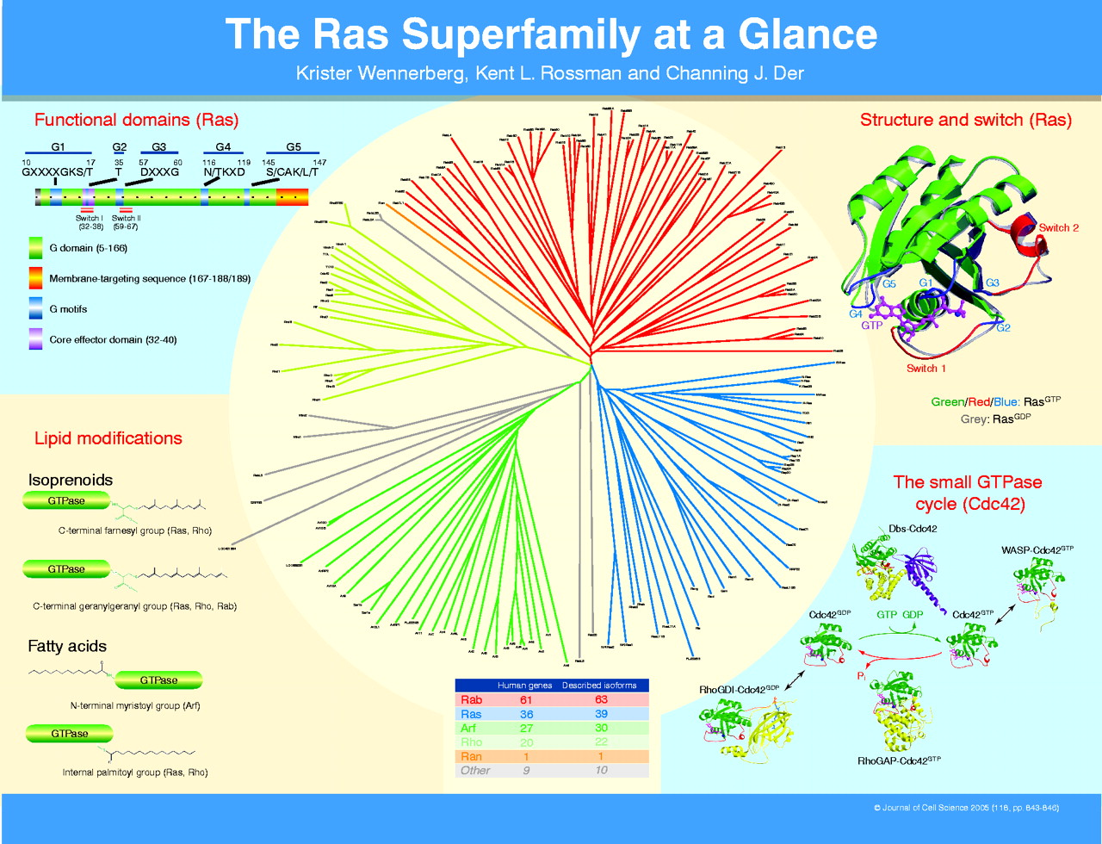
IT’s ALL RElative
Notes:
-Before we discuss KRAS’s roles in cancer, it is important to note that it belongs to the ‘RAS superfamily’
-members of the ras family include: Rab, Arf, Rho, and Ras proteins among others AND has over 150 proteins total
-These proteins are upstream effectors of a wide variety of cell cycle pathways

Slide 6
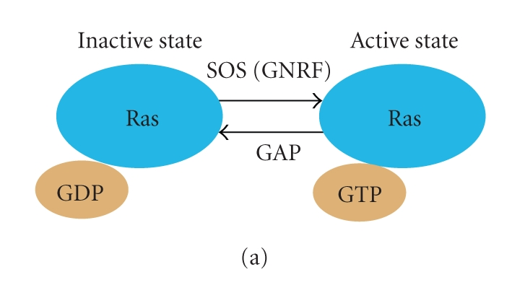
SMALL G THANGS (or gTPases)
Notes:
-RAS superfamily proteins are what are called ‘small GTPase proteins’
-When bound to GDP (guanosine diphosphate), Ras is ‘inactive’ (i.e. does not activate downstream proteins)
-GEF (guanine exchange factor) proteins ‘kick off’ the GDP, allowing GTP to bind
-GTP binding leads to RAS activation (i.e. RAS begins to target downstream effector proteins)
-In order to return to the inactive state, the GTP must be hydrolyzed to GDP
-Ras has intrinsic GTPase activity, but its slow
-GAP (or gtp-ase activating) proteins increase this activity 100,000 fold, causing GTP hydrolysis

Slide 7
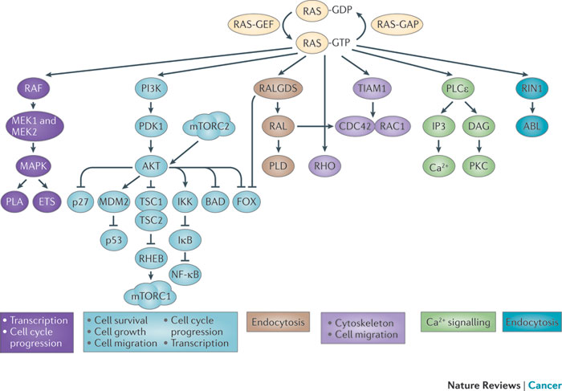
Kind of a big deal
AND MUCH MORE!
Notes:
-without getting into too much detail, RAS has a LOT of downstream effects
-for instance:
-transcription, cell cycle progression
-cell survival, growth, migration, and transcription
-endocytosis
-cytoskeletal morphology and cell migration
-calcium signaling
-AND MORE

Slide 8
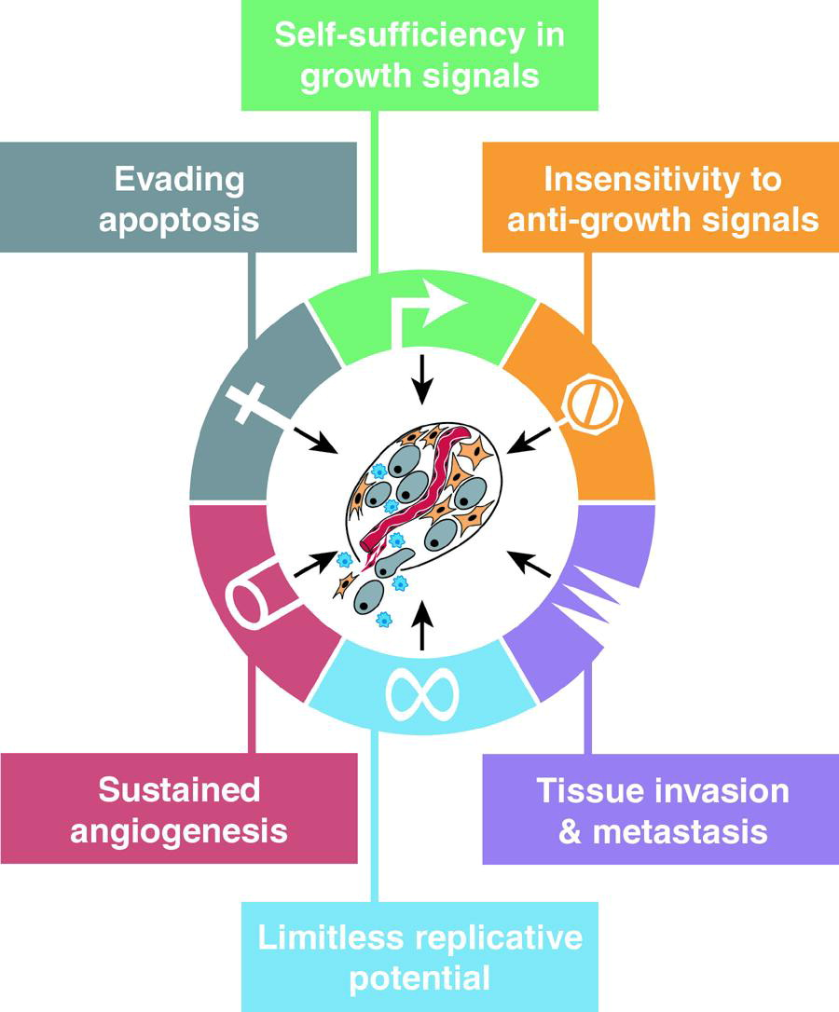
EERILY SIMILAR
Notes:
-you will notice that a lot of these functions are eerily similar to the ‘hallmarks of cancer’

Slide 9
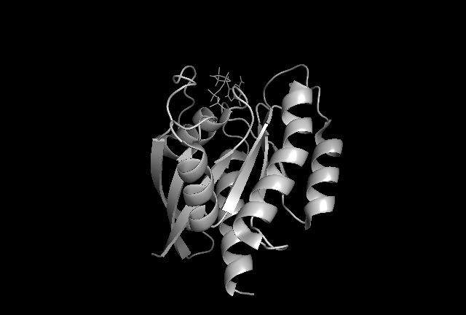
WhAt’s Up with KRAS?
Notes:
KRAS contains 188 amino acid residues with a mass of 21.6 kD
This is the overall structure of KRAS, it is comprised of 188 aa residues and has a mass of 21.6 kD
There are four major domains
The G domain (pink) is actually made up of three separate domains
Amino acids 1-85 are conserved in KRAS, HRAS and NRAS
Amino acids 86-165 are only 70-80% conserved
The core effector domain is a small part of the former domain- this is the region that allows RAS to interact with downstream effectors and GAPs
7) Finally the highly variable C-terminal domain helps anchor RAS to the membrane
8) The most important regions of KRAS are the P Loop (in pink), Switch 1 (in green), and Switch 2 (in purple regions) – they help bind GDP and GP and aid in hydrolysis
9) The most commonly mutated residues (glycine 12, glycine 13, and glumate 61) are in this region
10) You can see the GDP molecule in yellow
*PDB 4OBE

Slide 10
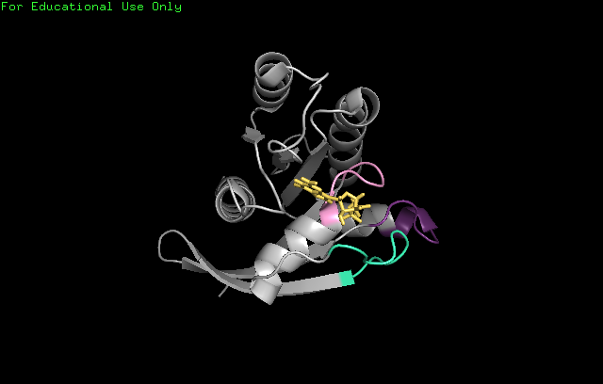
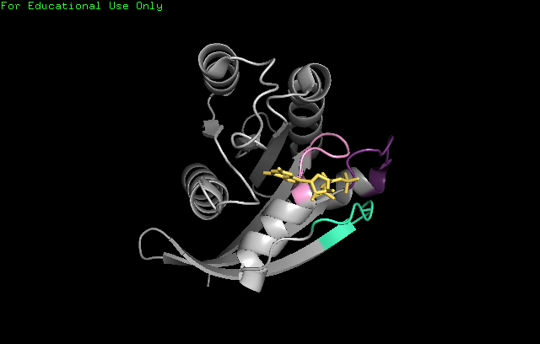
Shift Happens
Notes:
GDP v GTP

Slide 11
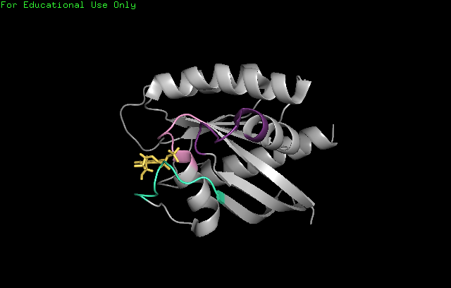
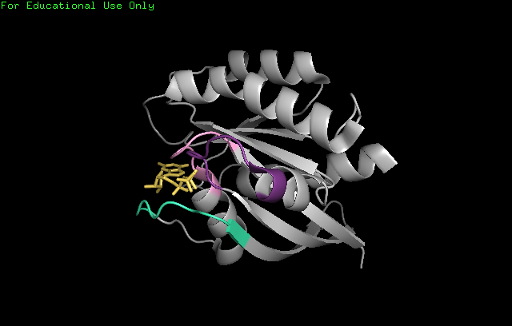
Shift Happens
Notes:
GDP v GTP

Slide 12
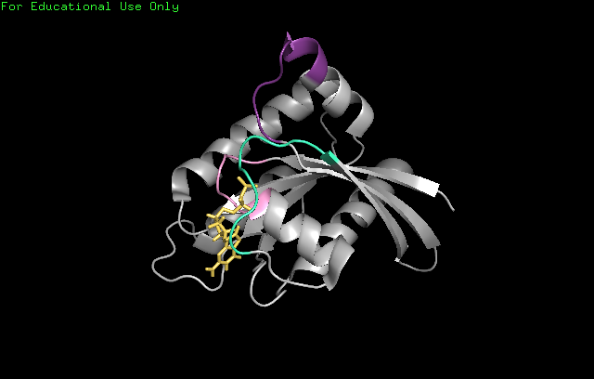
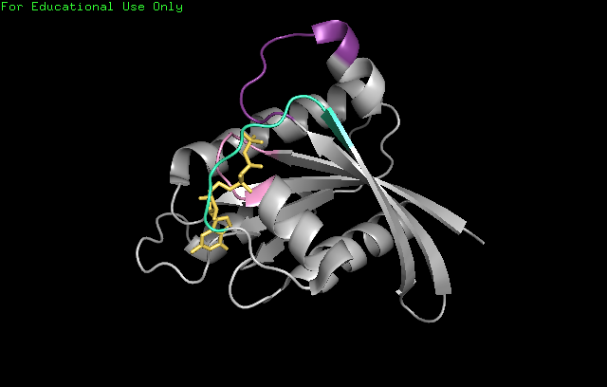
Shift Happens
Notes:
GDP v GTP

Slide 13
STICKY BRakes
WT KRAS is a tumor suppressor gene
Mutant KRAS removes the brakes
Most frequent mutations are at positions 12 and 13
‘Freezing’ in GTP bound position
Others at 61, 63, 117, 119, 146
Changes in GDP/GTP affinity
TL;DR: KRAS remains activated
Notes:
- As it turns out, WT KRAS is a tumor suppressor gene
-that means that when its functioning properly, it prevents cancer by acting like the breaks on a car (preventing out of control growth and proliferation)
-Mutations in KRAS function much like cutting the brakes on a car
-The most frequent mutations occur at positions 12 and 13 – these result in KRAS ‘freezing’ in the GTP bound position
-less common mutations at positions 61, 63, 117, 119, or 146 result in changes in GDP/GTP affinity, promoting KRAS binding to GTP

Slide 14
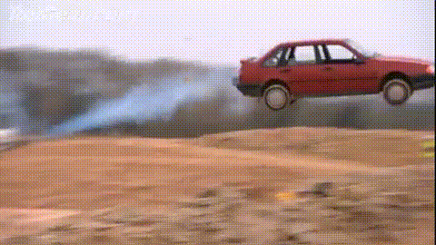
STICKY BRakes

Slide 15
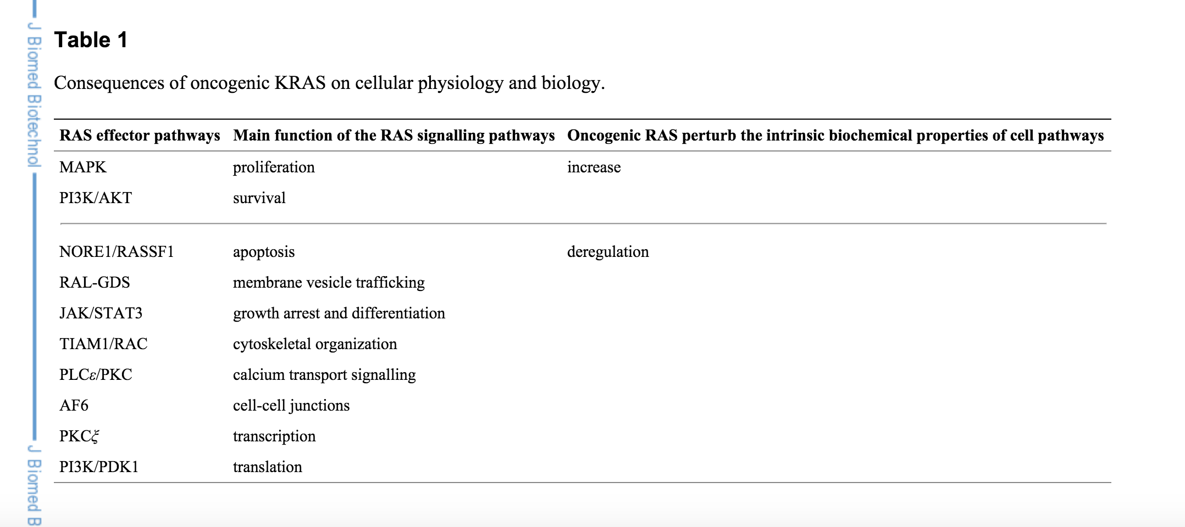
STICKY BRAKES
Notes:
-Specifically, when KRAS is mutated it results in the disruption of all of these pathways
-this leads abnormal, invasive, uncontrolled cell growth…i.e. cancer

Slide 16
KRAS MUTATIONs are BAD
Extremely common:
>80% of pancreatic carcinomas
40-50% of colon carcinomas
30-50% of lung carcinomas
And more…
Poor prognostic outcome
Non-specific chemo and radiation
Tyrosine kinase inhibitors
Gefitinib, erlotinib
Acquired resistance
cetuximab
Notes:
You have probably picked this up, but KRAS mutations are bad
-Not only are they bad, they are VERY common
-pancreatic : 93% mortality rate after 5 years
-colon” 35.1%
-lung 83.4%
-in addition, KRAS mutations lead to poor prognostic outcome when they are present in any cancer
-KRAS mutations lead to higher rates of mutation for ‘non-specific chemotherapy and radiation)
-so do other things, such as mutations in the EGFR (epidermal growth fctor receptor) gene
-typical treatment for chemo resistant cancer involves EGFR-tyrosine kinase inhibitors
-KRAS positive cancers, however, are also typically resistant to these drugs
-in one study, 77% of patients with EGFR mutations were sensitive (i.e. responded to gefitinib or erlotinib) but 0% of patients with a KRAS mutation showed any response
-KRAS mutations also seem to promote acquired resistance to chemo
-for instance patients with KRAS mutations may initially respond to cetuximab, but often this does not work for long

Slide 17
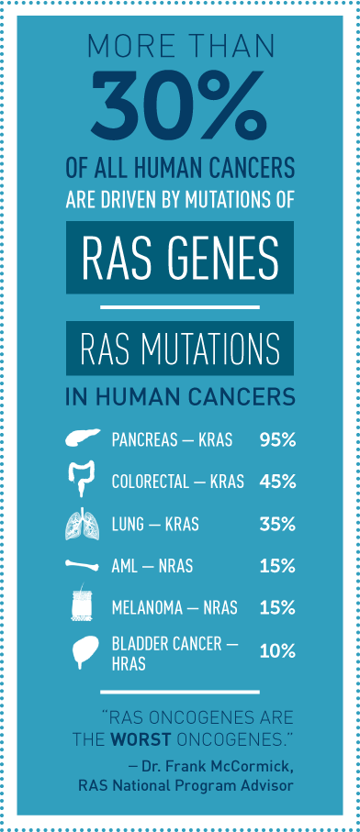
NIH:
Notes:
-you know if the government is starting an ‘initiative, it must be really really bad’
-see quote!

Slide 18
FUTURE DIRECTIONS
KRAS (as well as HRAS and NRAS) have been regarded as ‘un-druggable’
The government assures us that hope is not lost…
Possible future targets
Downstream effectors
GAPs/GEFs
PM localization
Highly specific RNAi
Largest problem: discriminating between WT and mutant KRAS
Notes:
-unfortunately, KRAS (and its fellow RAS family members) have often been regarded as ‘undruggable’
-gov’t
-some possible targets include…
-as yet, there is no ‘good’ way to treat KRAS mutations
-one of the largest problems remaining…
-why I’m in favor of highly specific RNAi

Slide 19

ALWAYS REMEMBER…
Notes:
KRAS remains an ongoing problem!

Slide 20

Questions?

Slide 21
References
Cox, Adrienne D, and Channing J Der. “Ras History: The Saga Continues.” Small GTPases 1, no. 1 (2010): 2–27. doi:10.4161/sgtp.1.1.12178.
Jančík, Sylwia, Jiří Drábek, Danuta Radzioch, and Marián Hajdúch. “Clinical Relevance of KRAS in Human Cancers.” Journal of Biomedicine and Biotechnology 2010 (2010): 150960. doi:10.1155/2010/150960.
Shima, Fumi, Shigeyuki Matsumoto, Yoko Yoshikawa, Takashi Kawamura, Masayuki Isa, and Tohru Kataoka. “Current Status of the Development of Ras Inhibitors.” Journal of Biochemistry 158, no. 2 (August 1, 2015): 91–99. doi:10.1093/jb/mvv060.
Takashima, Asami, and Douglas V Faller. “Targeting the RAS Oncogene.” Expert Opinion on Therapeutic Targets 17, no. 5 (May 2013): 507–31. doi:10.1517/14728222.2013.764990.
Wennerberg, Krister, Kent L. Rossman, and Channing J. Der. “The Ras Superfamily at a Glance.” Journal of Cell Science 118, no. 5 (February 24, 2005): 843–46. doi:10.1242/jcs.01660.

Slide 22
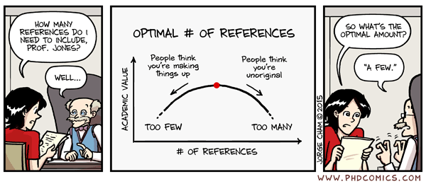
References

